Slide 1
Pet Store Management
DATABASE REPORT
3 CHI DEP
Group 2
Teacher: Nguyen Hong Phuong
Module: IT3290E – Database Lab
--- 20 Jan 2024 ---

Slide 2



MEMBER
Nguyen My Duyen
Doan Thi Thu Quyen
Tran Kim Cuong
Leader
Front-end / Back-end
Database Design
Back-end
Database optimizing
Back-end
Database query

Slide 3



Introduction
To help pet stores approach online business services, websites designed so that store owners can manage:
Products
Categories
Orders
……..
Customers can purchase some goods for their pets without visiting the shop, just through this websites.

Slide 4
TABLE OF CONTENTS
01
02
03
04
05
Operation
Technology used
Database
Feature
Entity – Relationship Diagram

Slide 5
01
Operation

Slide 6
ADMIN can
Manage products
Manage categories
Manage users

Slide 7
USER can
View categories,
products
Manage cart, orders
View orders, payment

Slide 8
Technology used
02

Slide 9




FRONTEND
DATABASE
BACKEND
VERSION CONTROL
SQL Server
HTML
PHP
Github

Slide 10
03
ERD

Slide 11
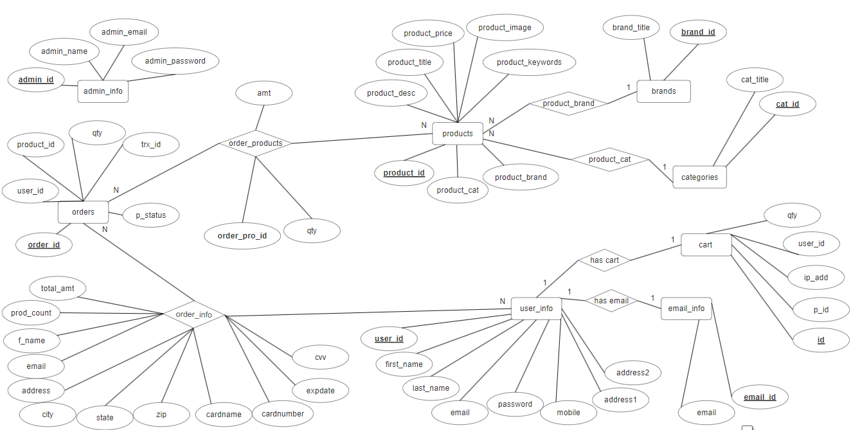
Entity Relationship Diagram

Slide 12
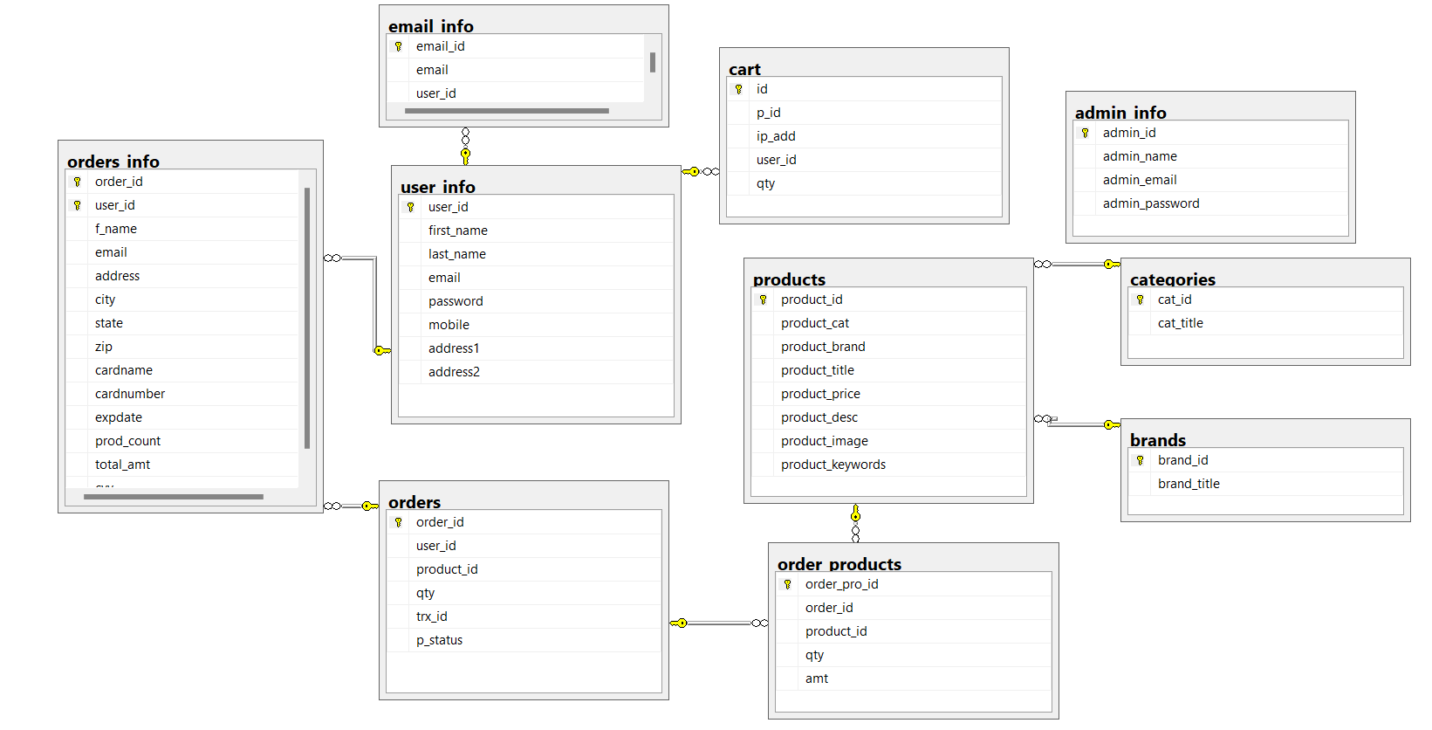
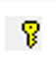
Database Diagram

Slide 13
Database
04
GUT

Slide 14
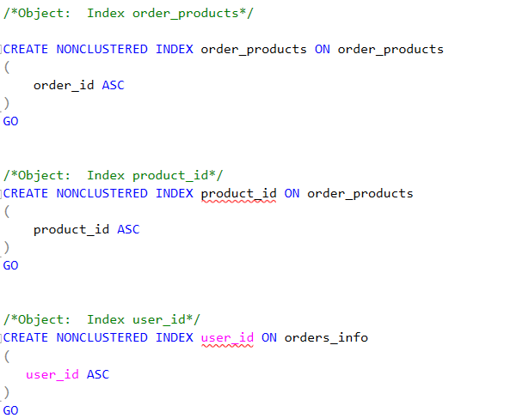
Index

Slide 15
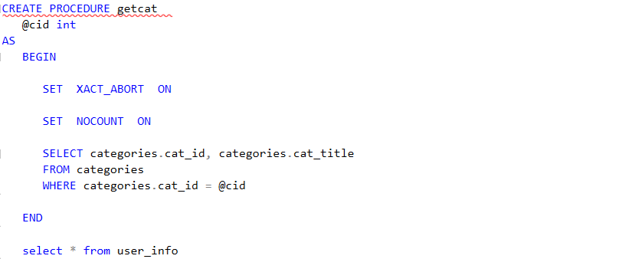
Procedure

Slide 16
05
Feature

Slide 17
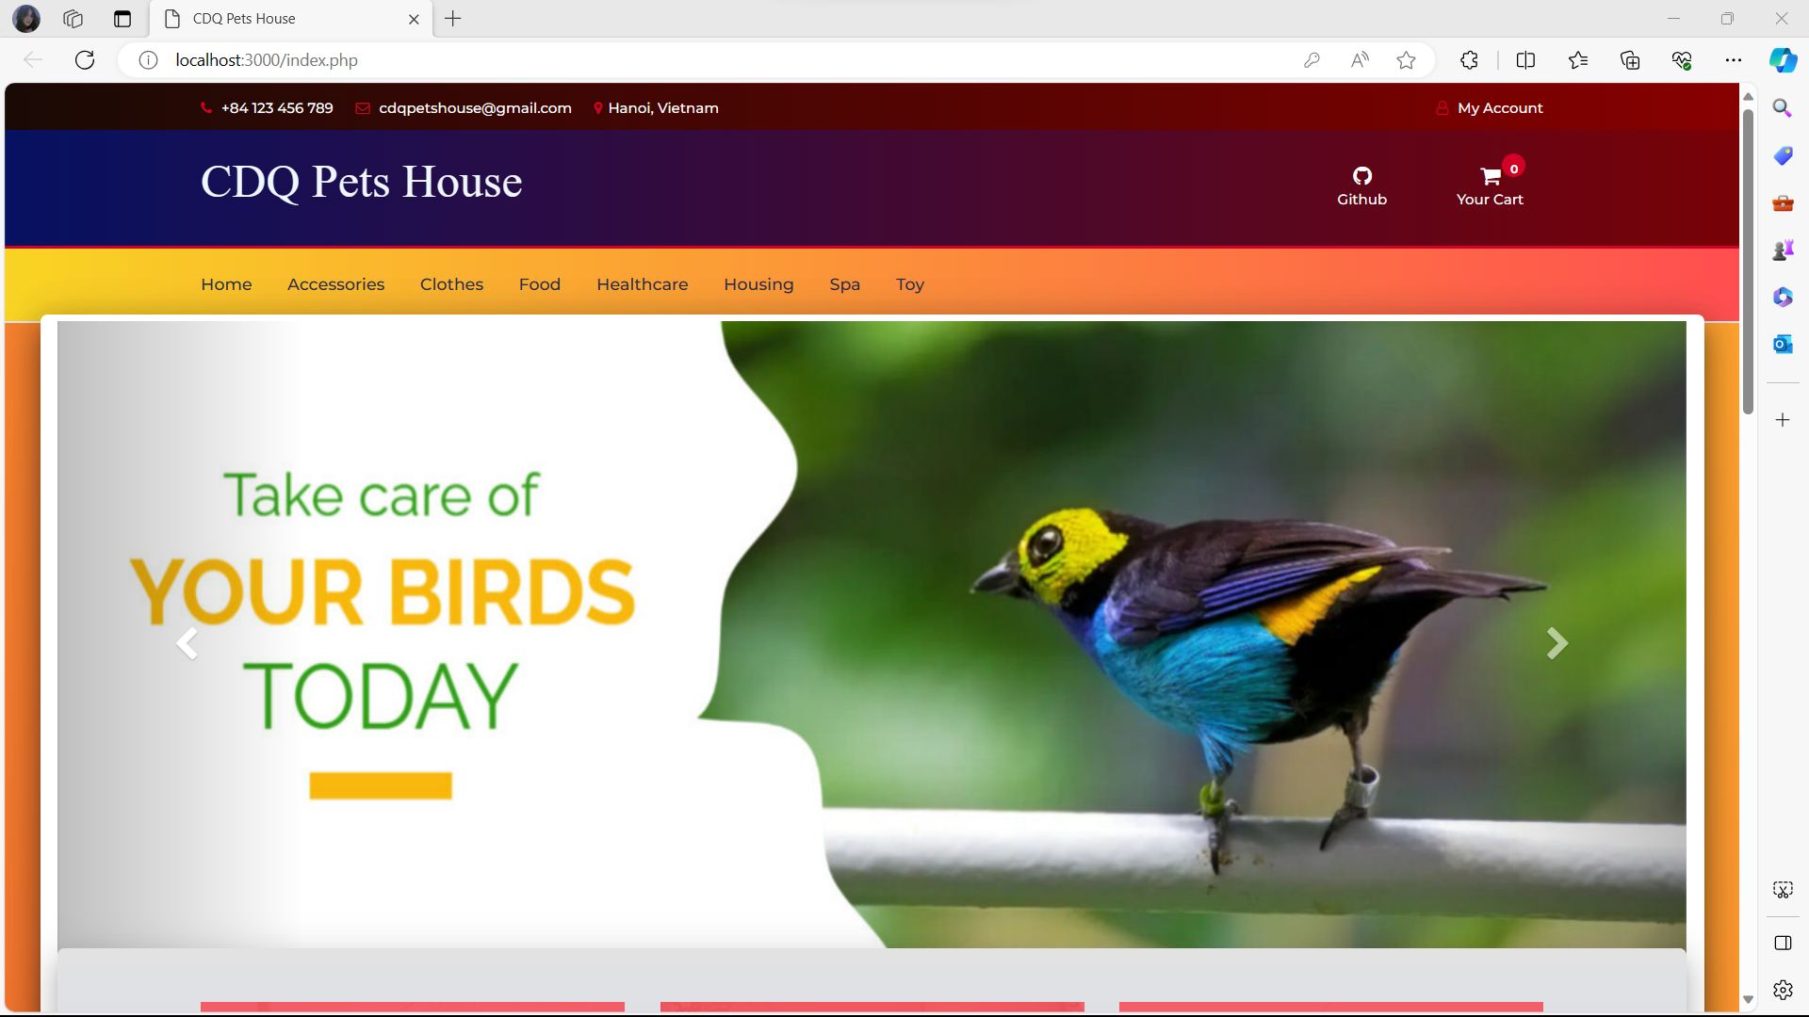
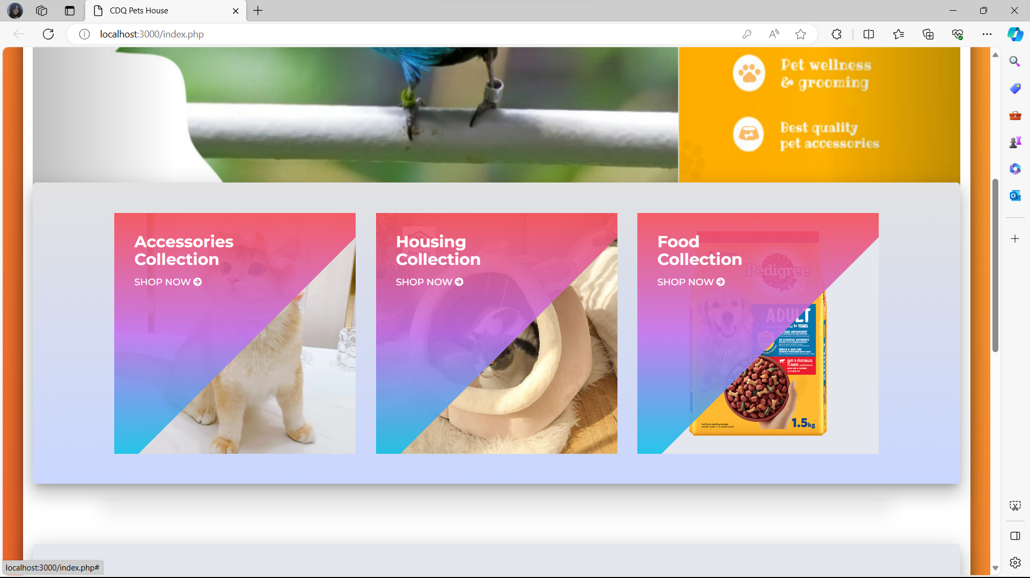
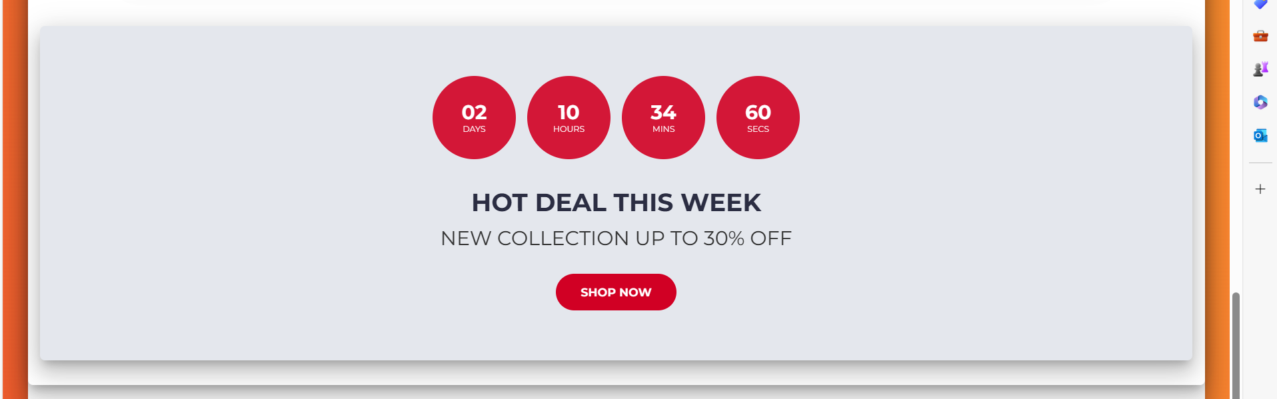
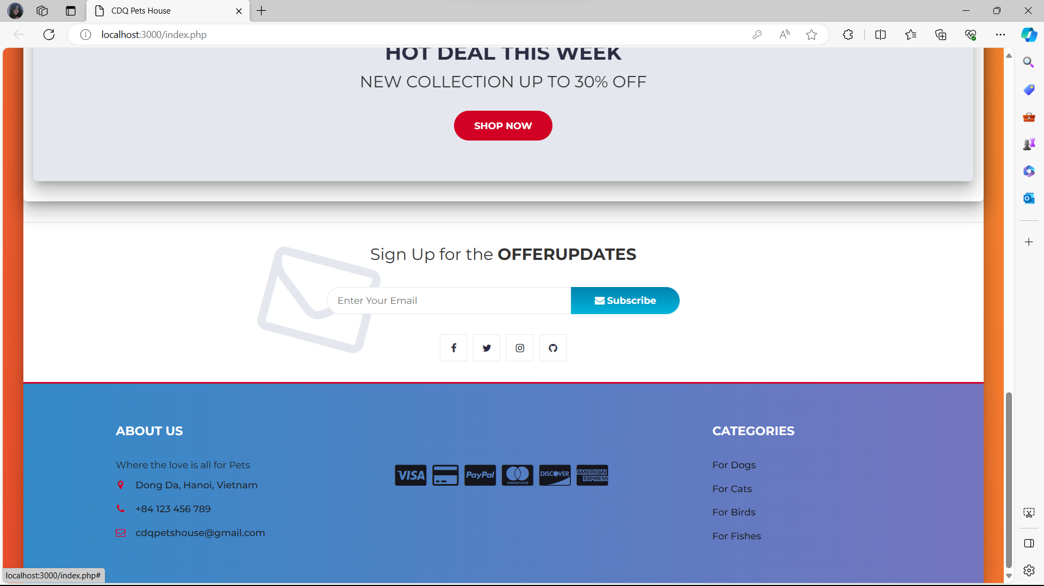
Landing page
Categories
Featured collection
Hot deal
update
The landing page – the introductory surface with some basic information:
Banners, featured categories, hot deal update, and contact details…
Contact
info

Slide 18
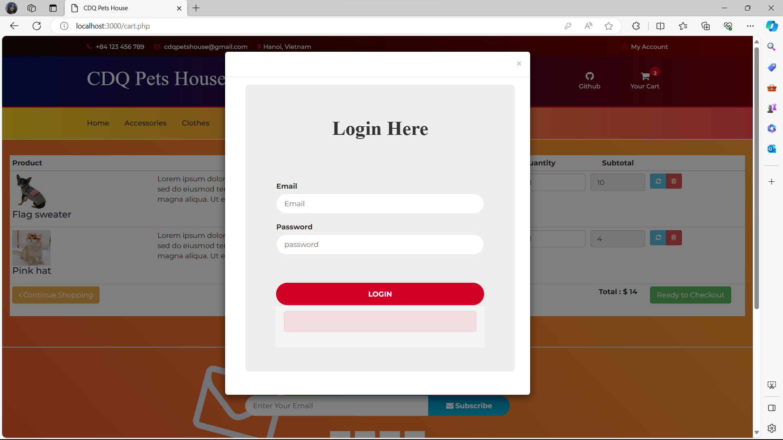
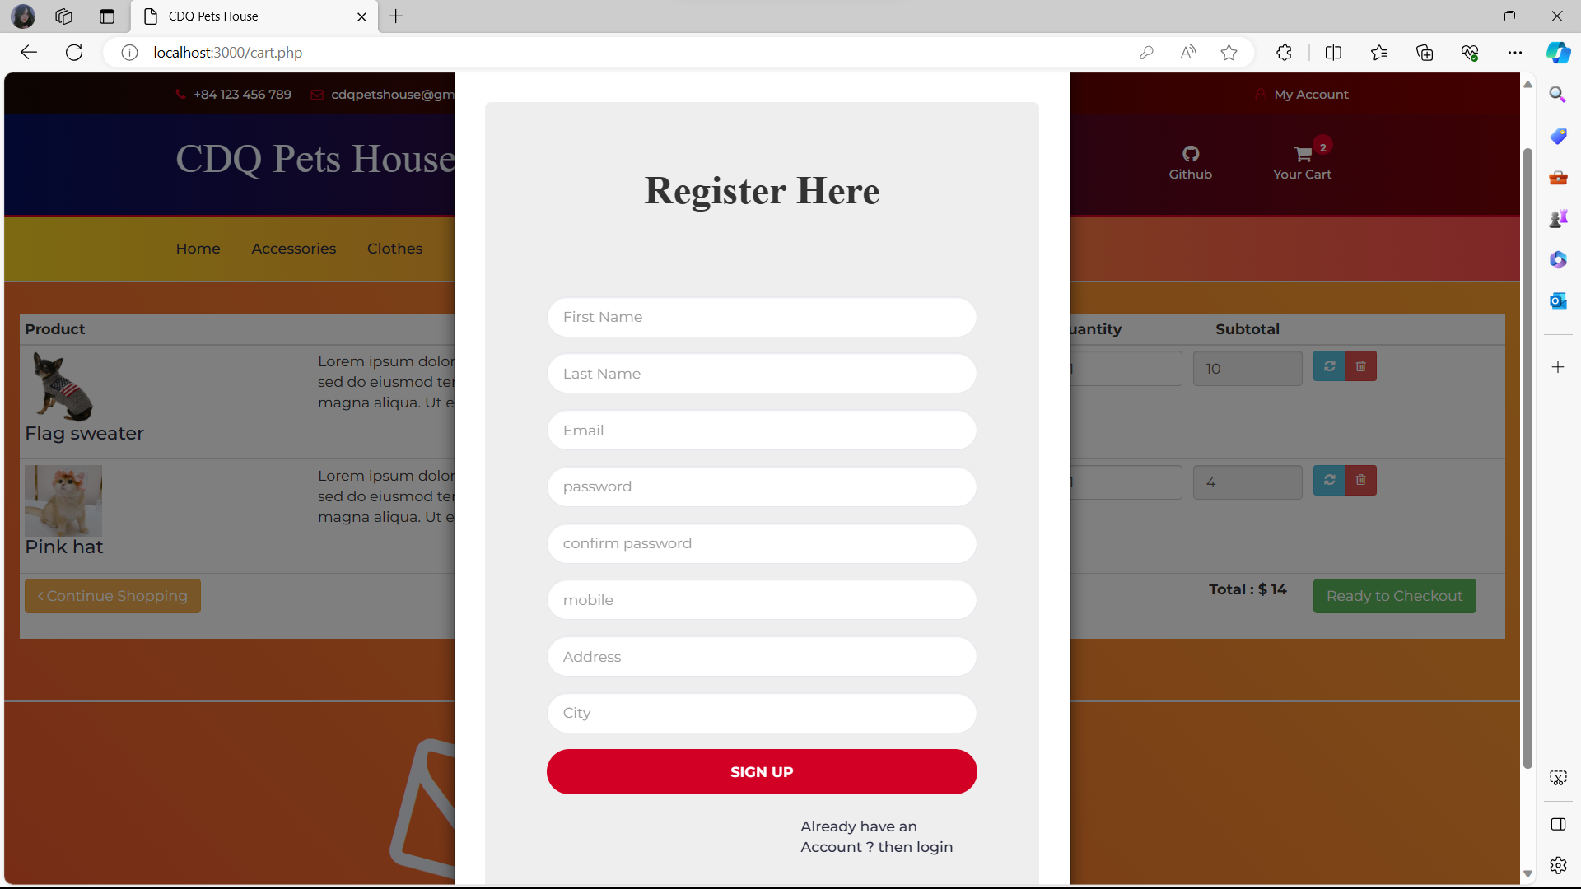
Login/Register box
Approaching this platform help users
- With login box:
Sign in the account they created before.
- With register box: Make a new account with their personal information.

Slide 19
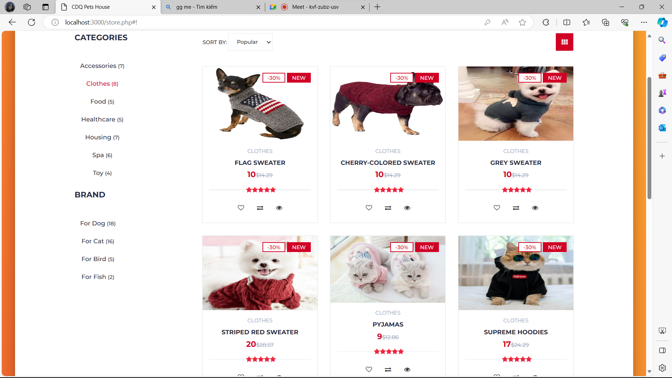
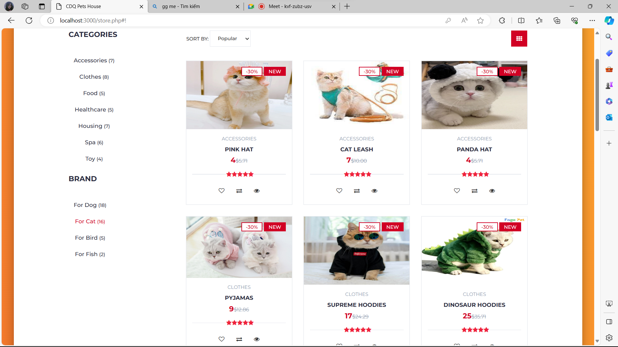
Products display
Where users will have a glance at all products from petstore

Slide 20
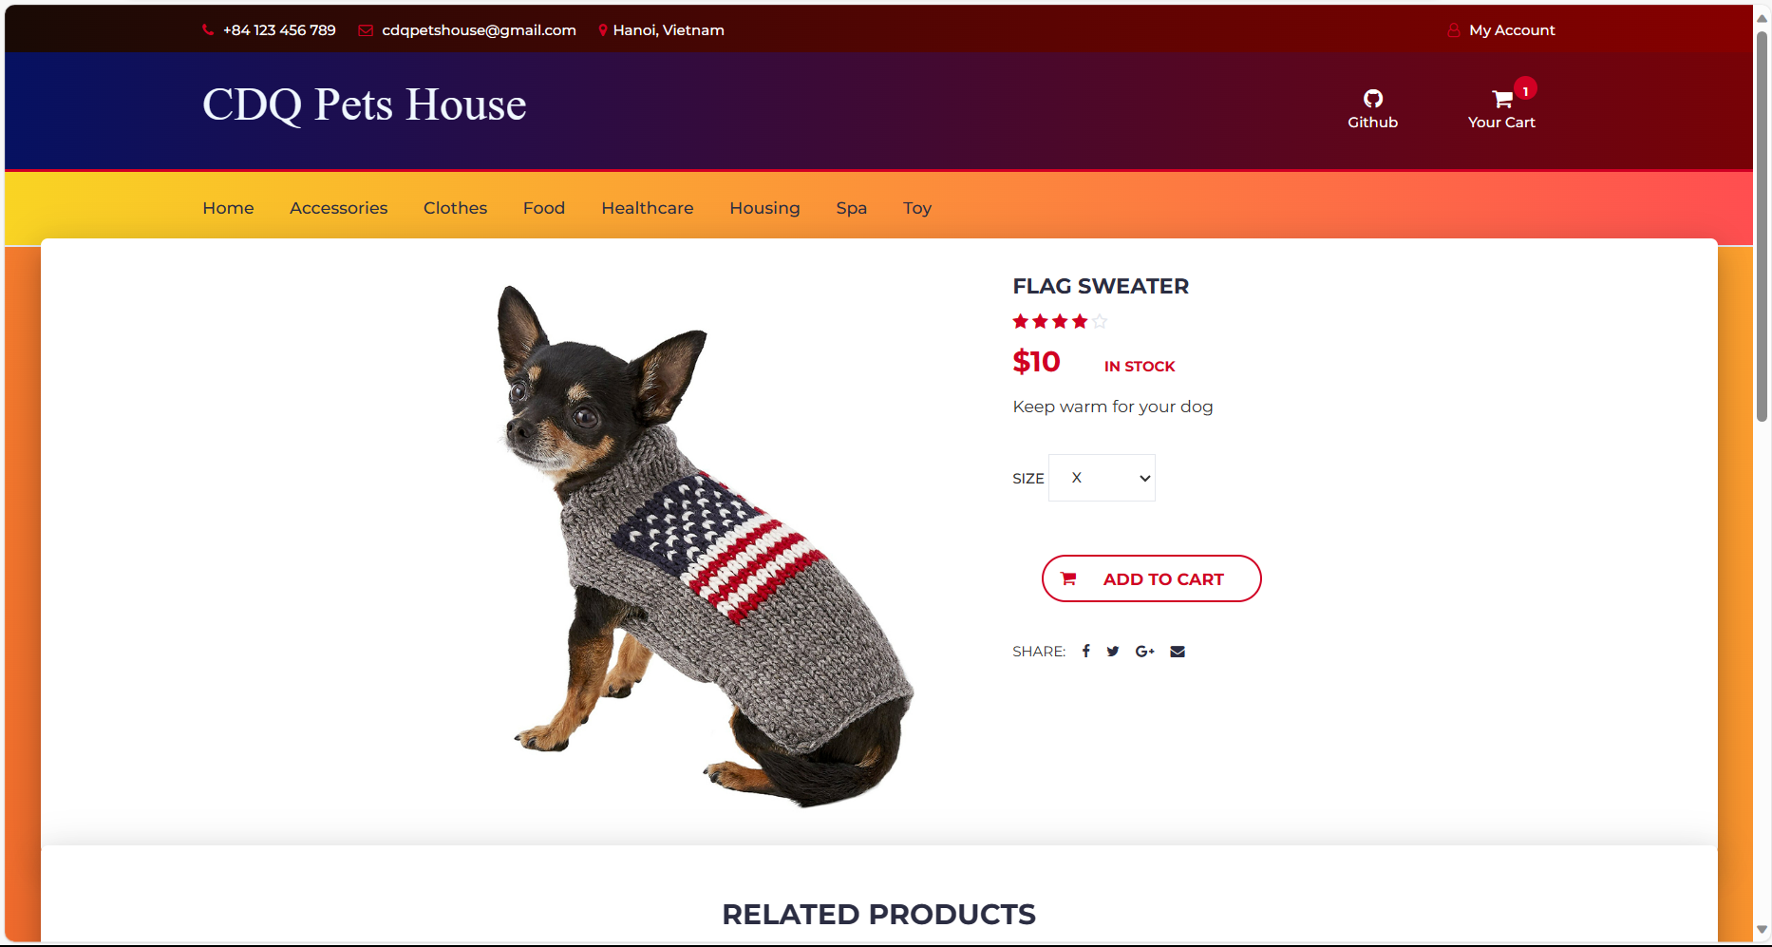
Product display
Where users will have a closer-look at a particular product from petstore.
They can add to their cart for purchasing, with properly size.

Slide 21
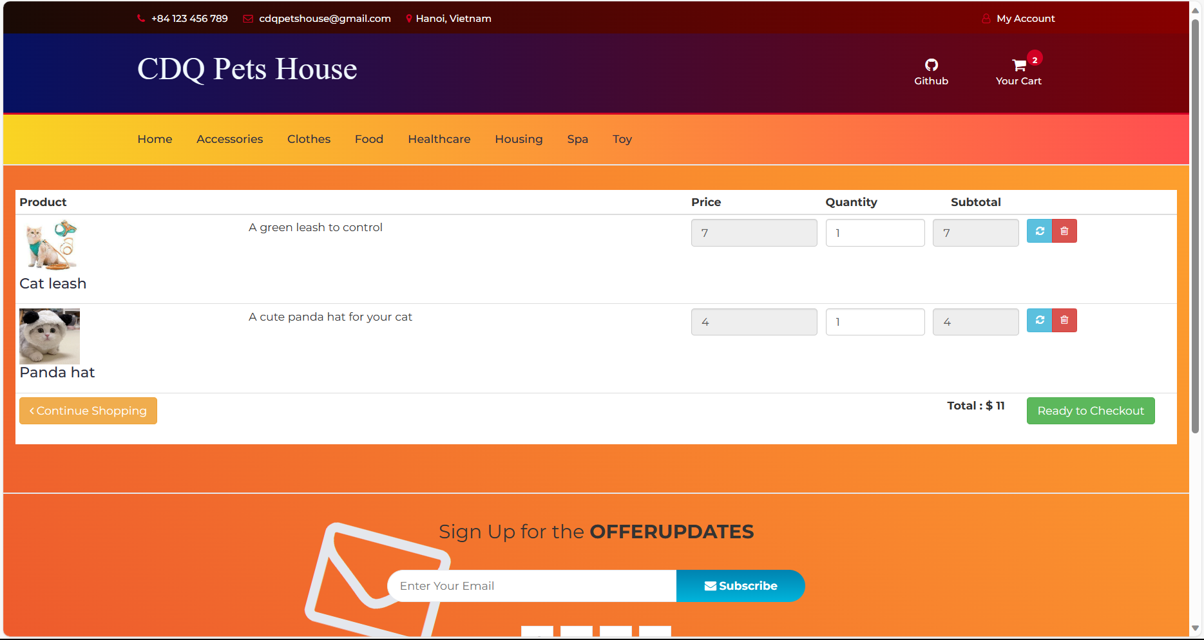
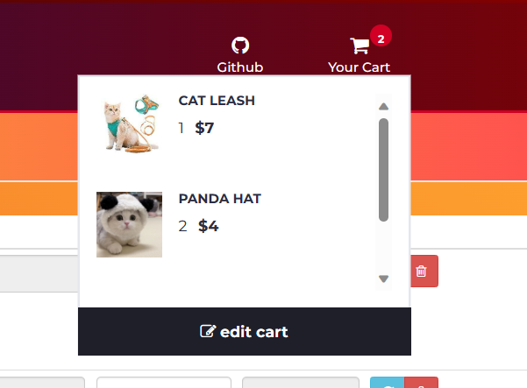
Cart page/box
Where users can check, add or remove by themselves before checkout and paying their bill.

Slide 22
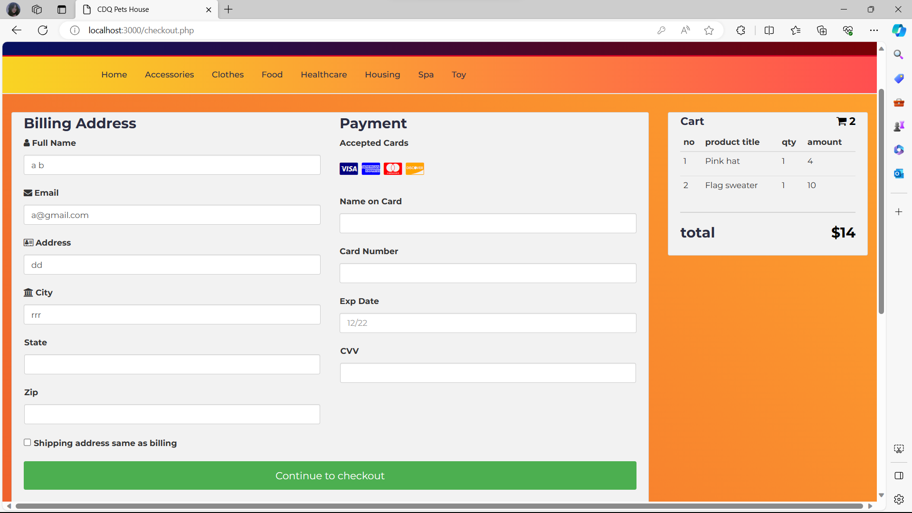
Payment page
The platform allows users to fill their personal information and payment information, to confirm before coding the shipping order

Slide 23
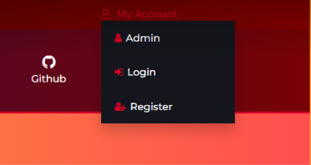
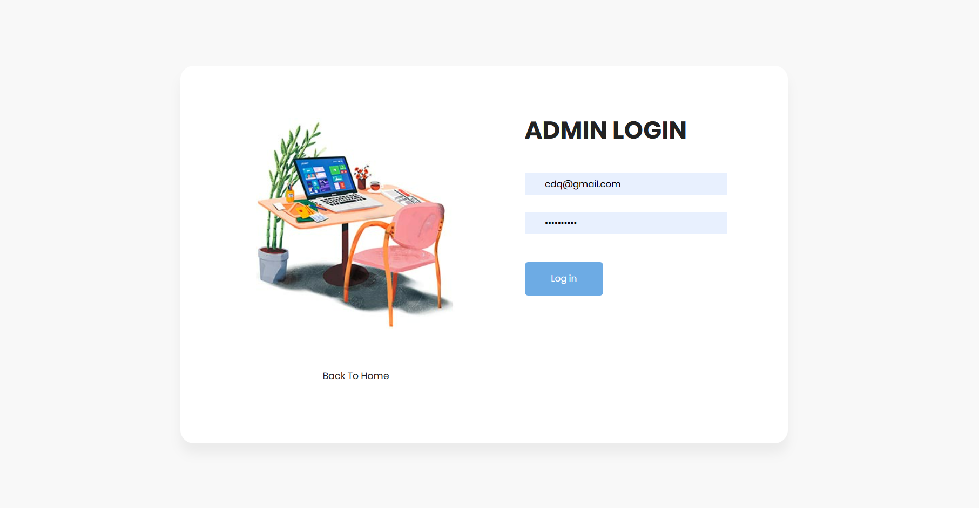
ADMIN LOGIN
At the “My account” box, click on “Admin” to sign in by admin account
For admin

Slide 24
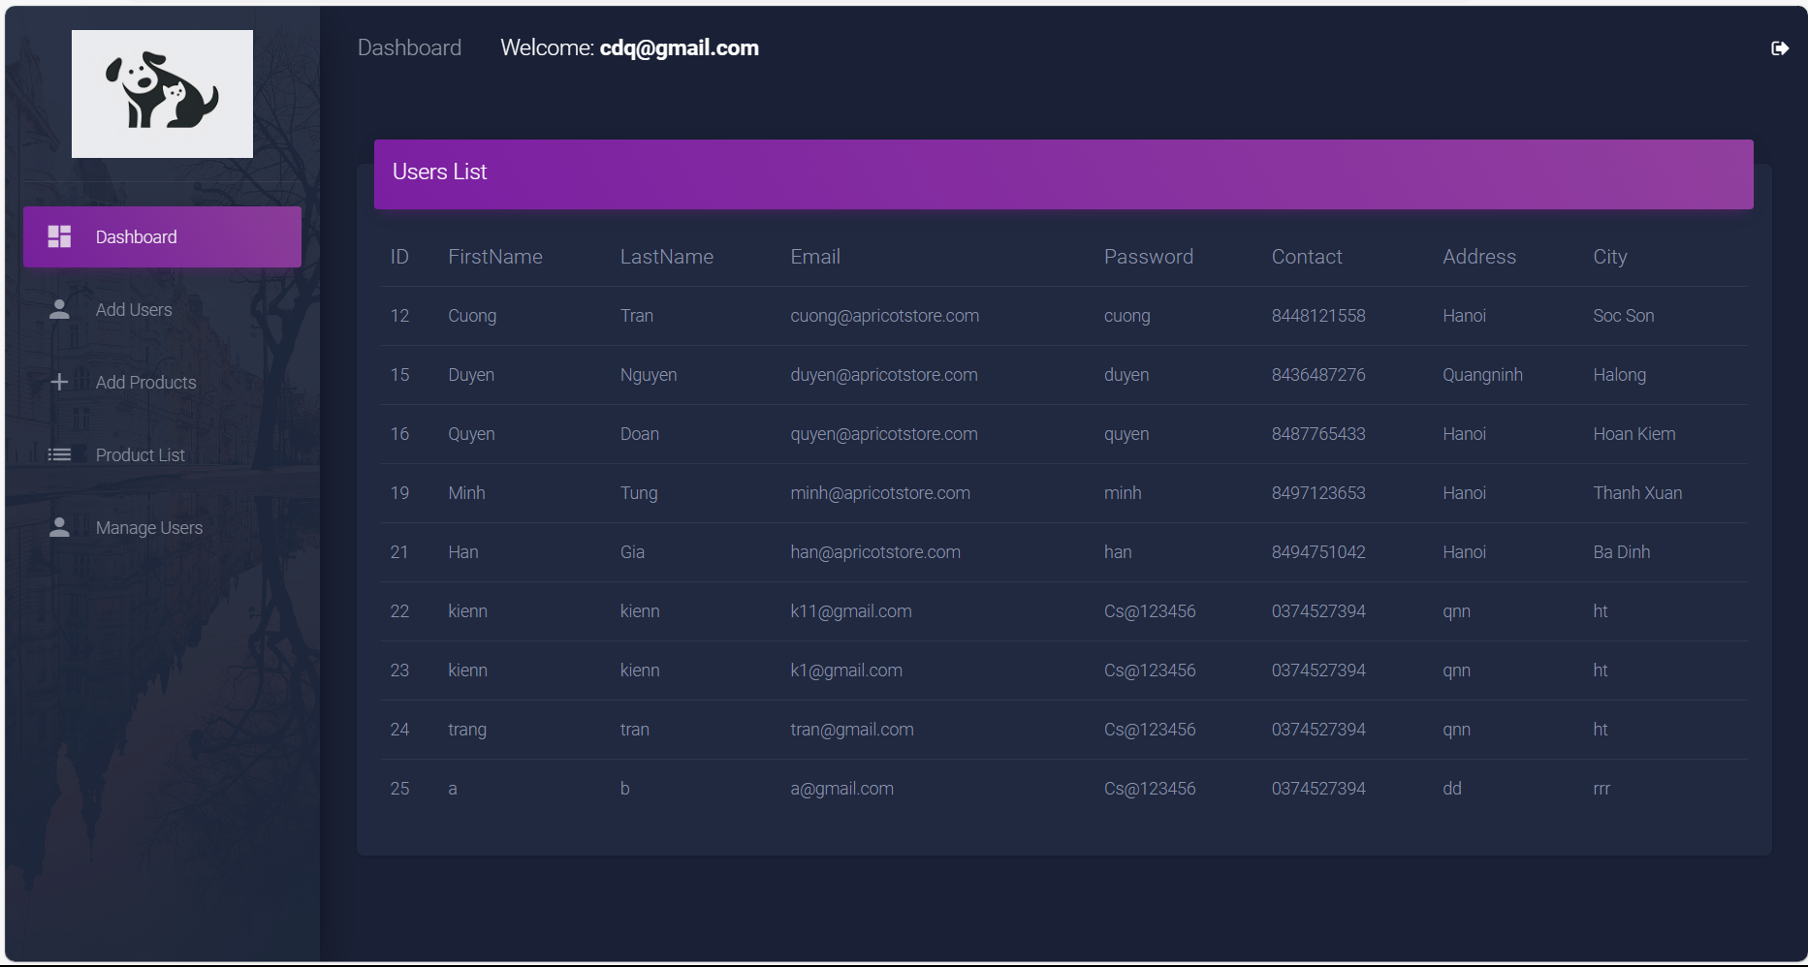
Users List: List of all users in the store
For admin

Slide 25
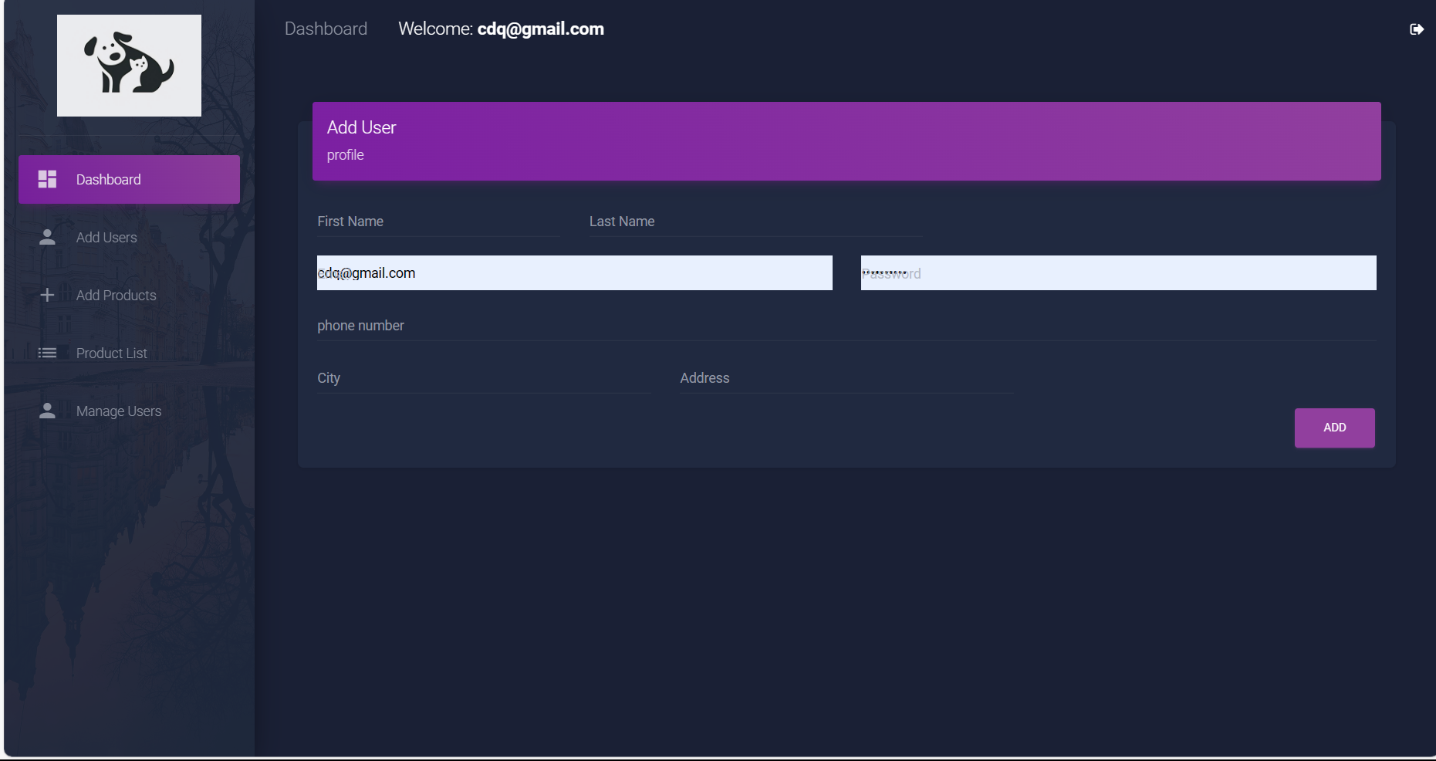
Add User: Create more user profiles for store
1. Fill all the necessary information
2. Click “Add”
For admin

Slide 26
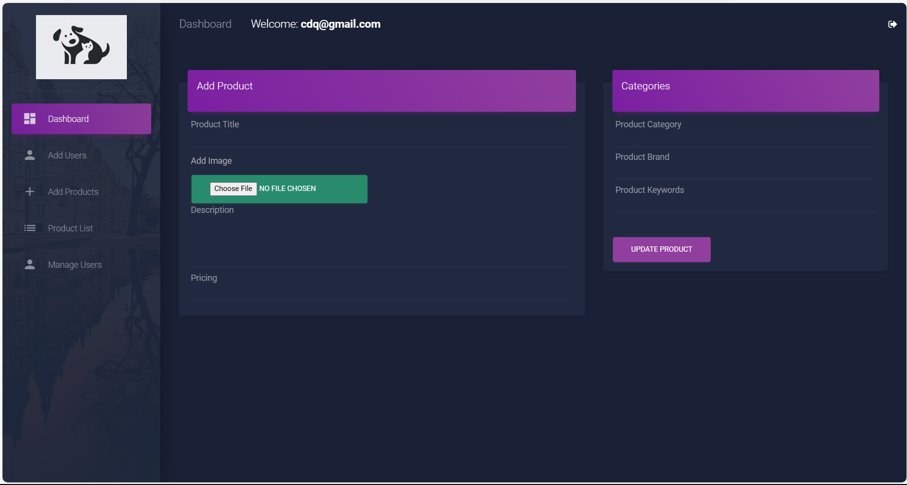
Add Products: Posting more products for sale
2. Fill the information for category, which the product belongs to
1. Fill the information for a product (supported image formats: .png, .jpg)
3. Click “Update product”
For admin

Slide 27
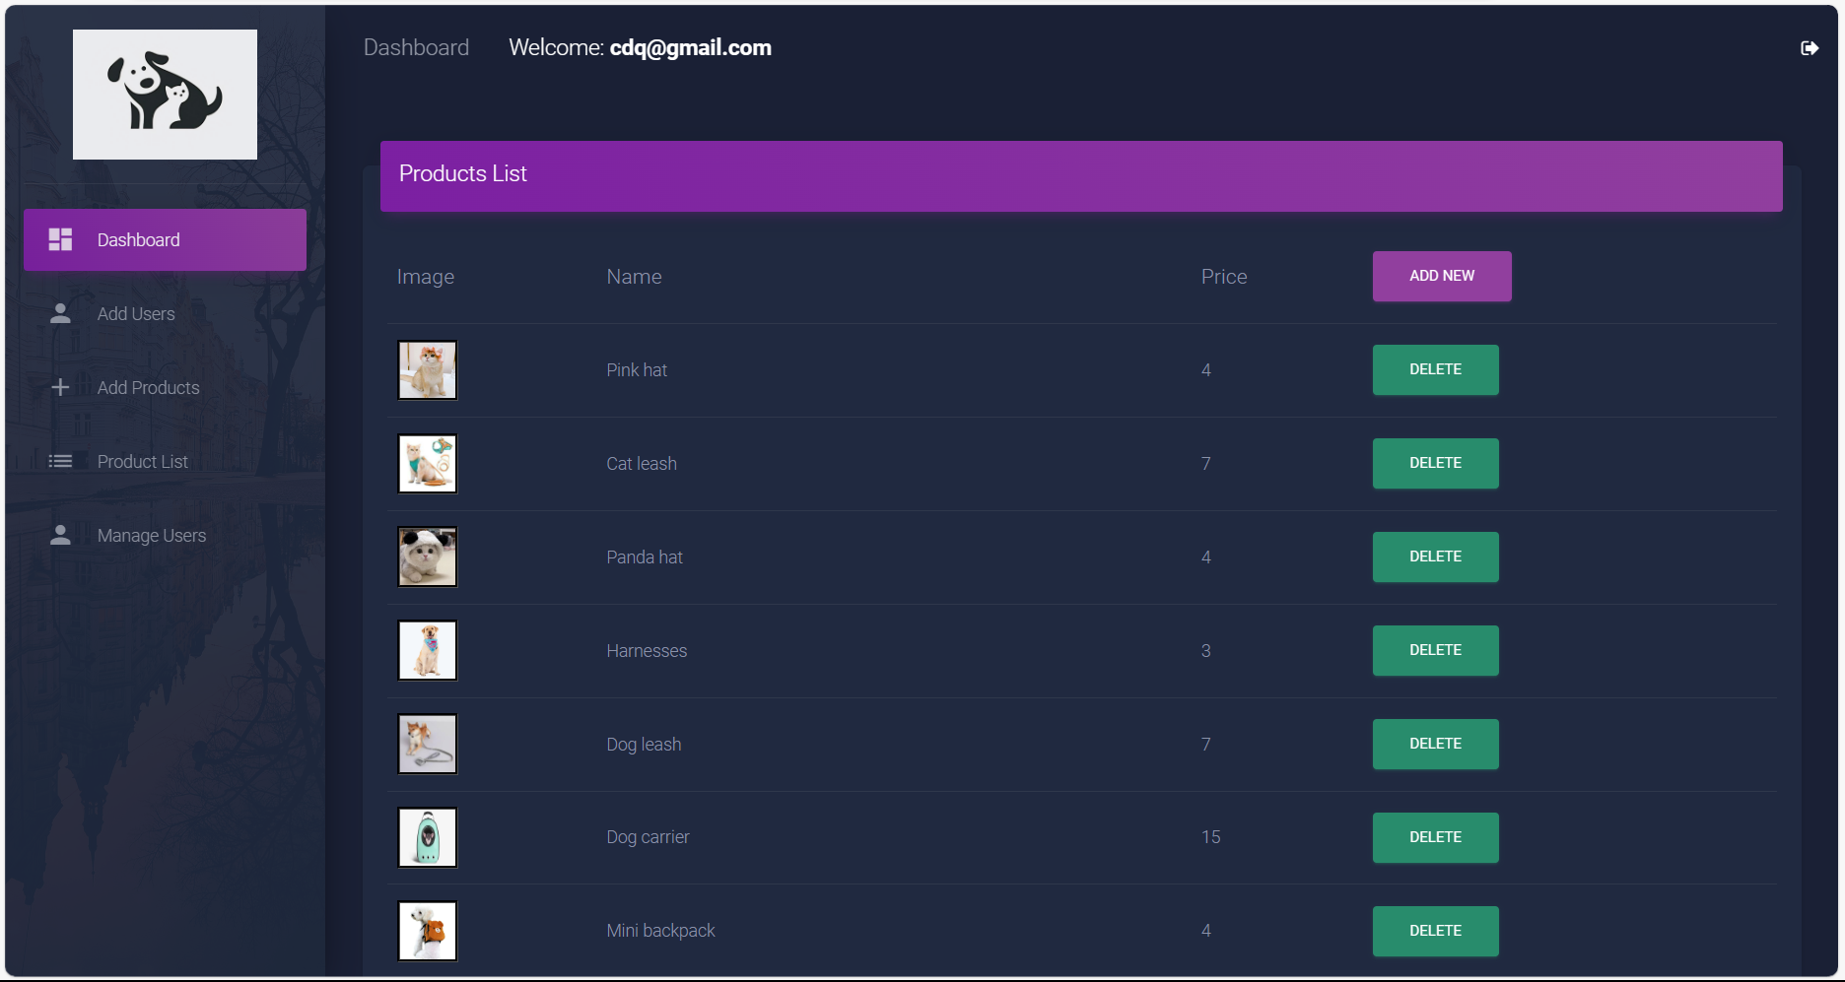
Products List: List of all products. Allow to add, delete
For admin

Slide 28
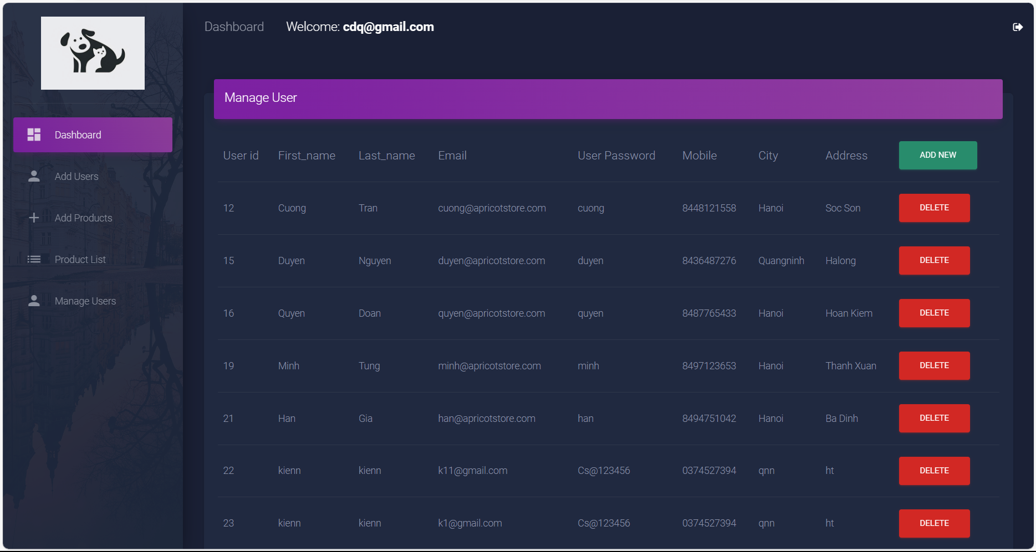
Manage Users: List of all users. Allow to add, delete
For admin

Slide 29

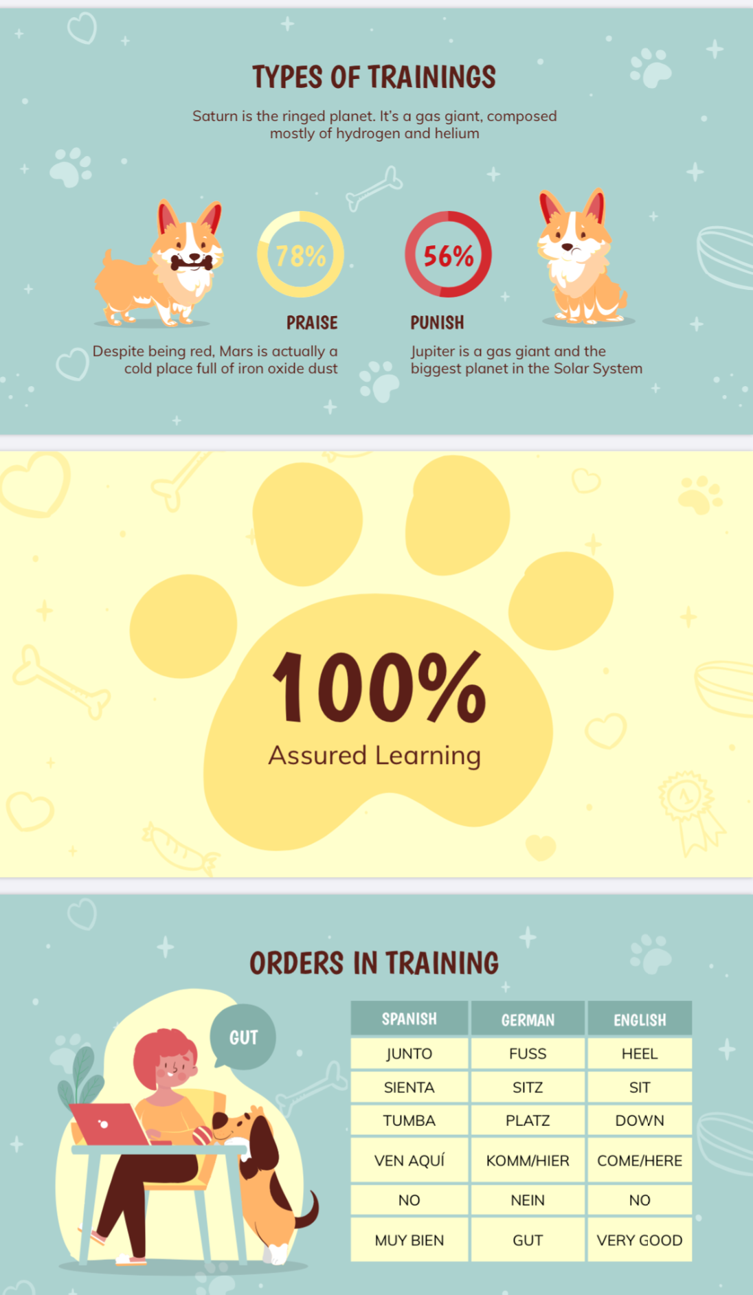



THANK YOU
Question
&
Discussion

